Slide 1
Stanford-Arm Manipulator (RRP)
Presented by:
Mohamed Moustafa Elsayed Ahmed

Slide 2
Table of Content
Schematic Diagram
Dynamics of Manipulator
Regressor & Parameter vector
PD Control
Perfect guesses
Aprox guesses
Passivty Control
Perfect guesses
Aprox guesses
Passivty Robust Control
Aprox guesses
Aprox guesses + weight at end-effector

Slide 3
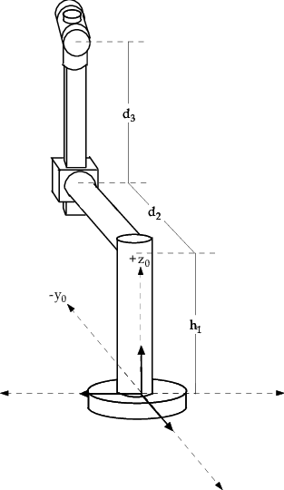
1- Schematic Diagram
Z
X
Y

Slide 4
Table of Content
Schematic Diagram
Dynamics of Manipulator
Regressor & Parameter vector
PD Control
Perfect guesses
Aprox guesses
Passivty Control
Perfect guesses
Aprox guesses
Passivty Robust Control
Aprox guesses
Aprox guesses + weight at end-effector

Slide 5

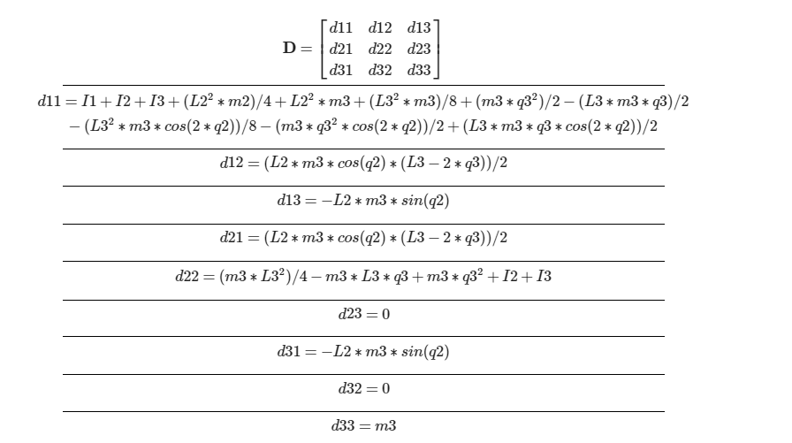
2- Dynamics of Manipulator

Slide 6
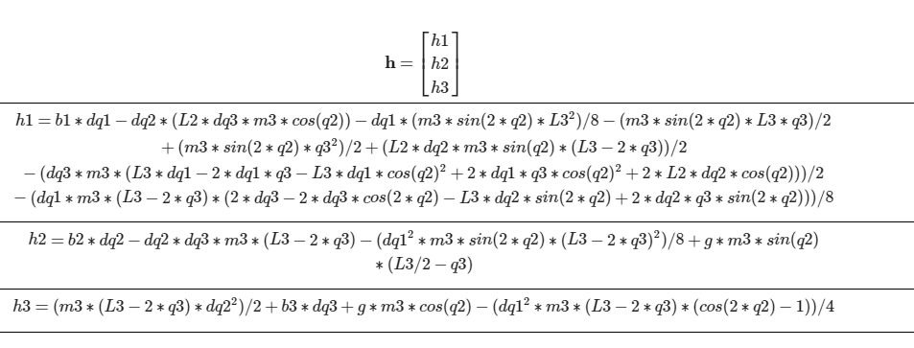
2- Dynamics of Manipulator

Slide 7
Table of Content
Schematic Diagram
Dynamics of Manipulator
Regressor & Parameter vector
PD Control
Perfect guesses
Aprox guesses
Passivty Control
Perfect guesses
Aprox guesses
Passivty Robust Control
Aprox guesses
Aprox guesses + weight at end-effector

Slide 8
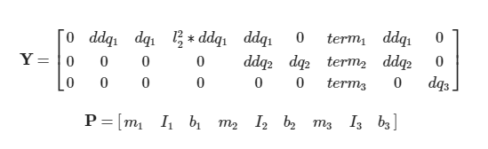
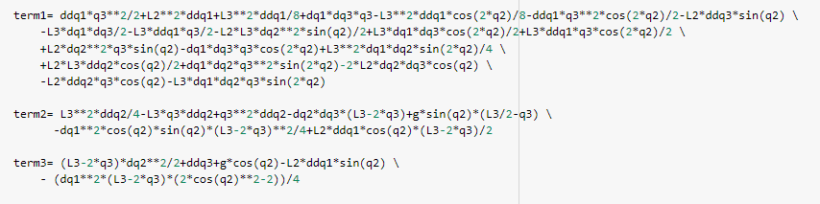
3- Regressor & Parameter vector

Slide 9
Table of Content
Schematic Diagram
Dynamics of Manipulator
Regressor & Parameter vector
PD Control
Perfect guesses
Aprox guesses
Passivity Control
Perfect guesses
Aprox guesses
Passivity Robust Control
Aprox guesses
Aprox guesses + weight at end-effector

Slide 10
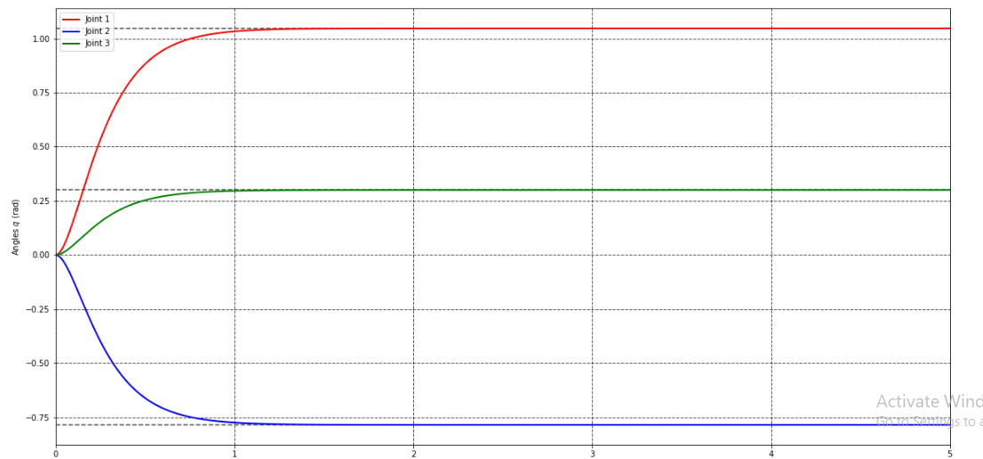
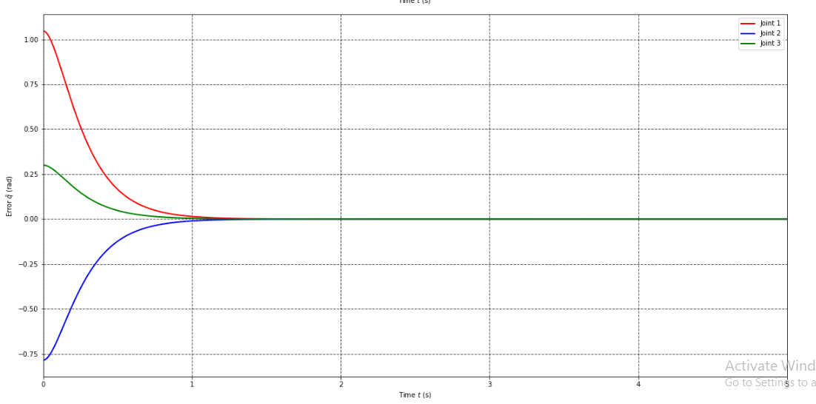
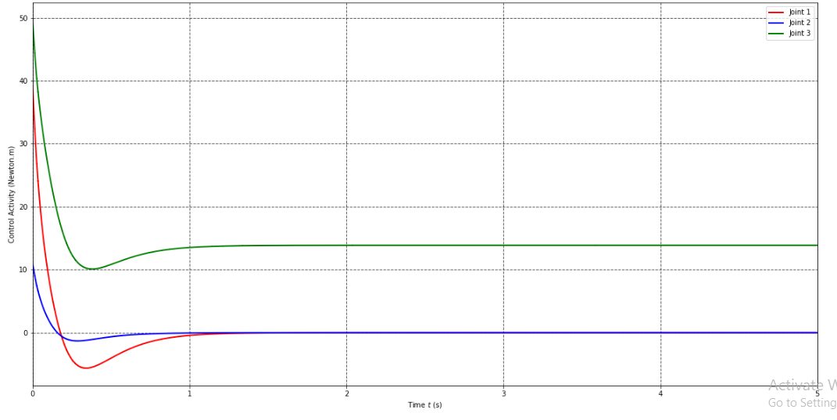
4- PD Controller (Perfect guesses)

Slide 11
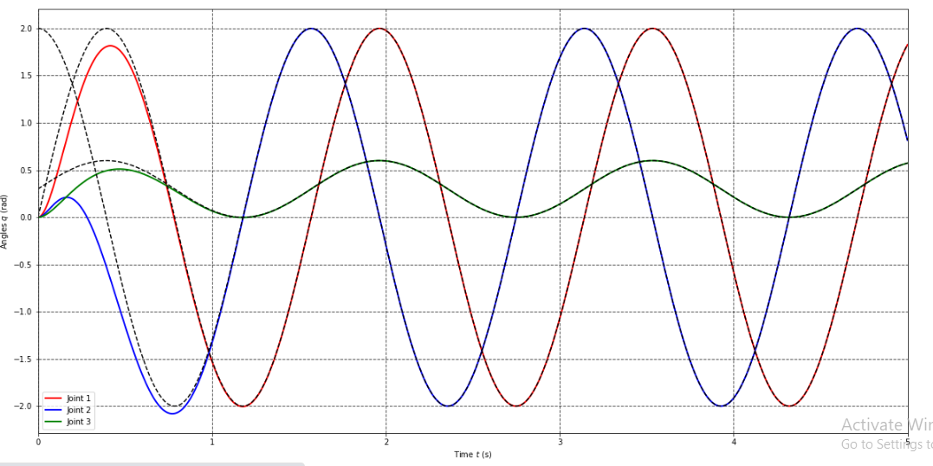
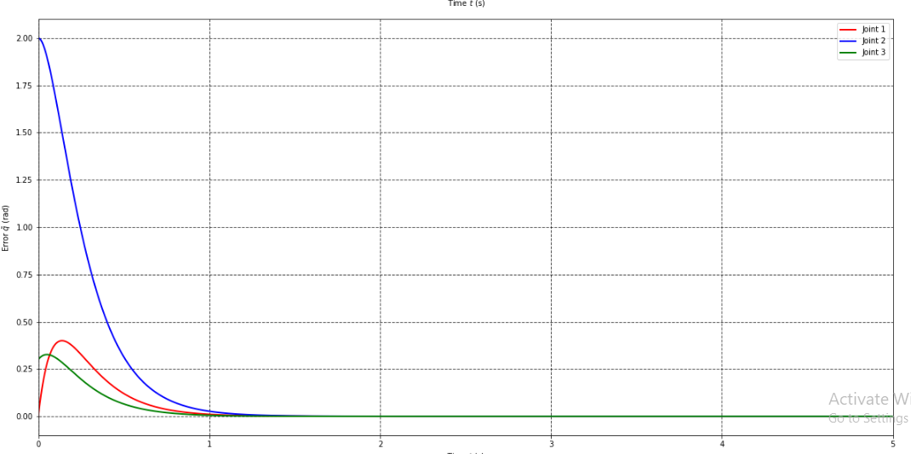
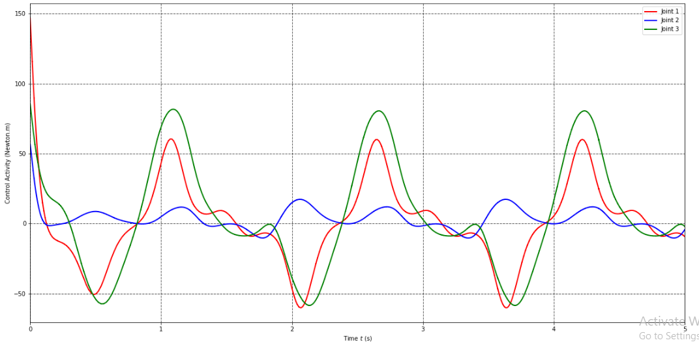
4- PD Controller (Perfect guesses)

Slide 12
Table of Content
Schematic Diagram
Dynamics of Manipulator
Regressor & Parameter vector
PD Control
Perfect guesses
Aprox guesses
Passivity Control
Perfect guesses
Aprox guesses
Passivity Robust Control
Aprox guesses
Aprox guesses + weight at end-effector

Slide 13
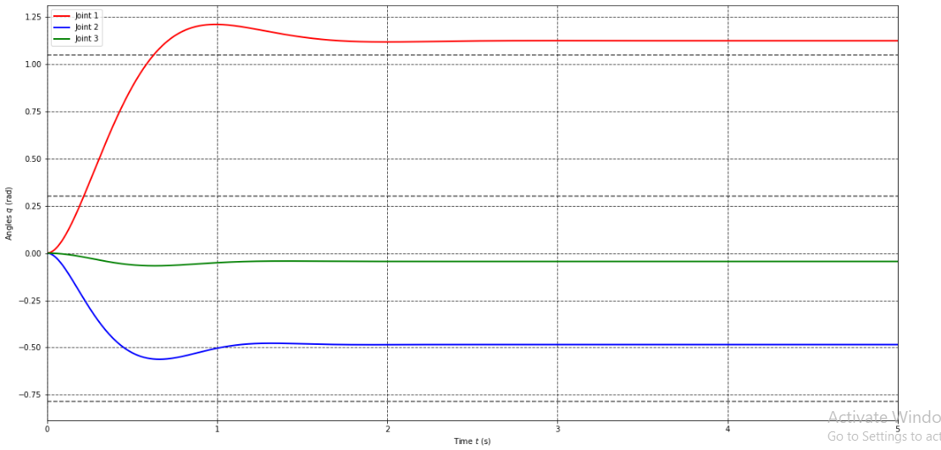
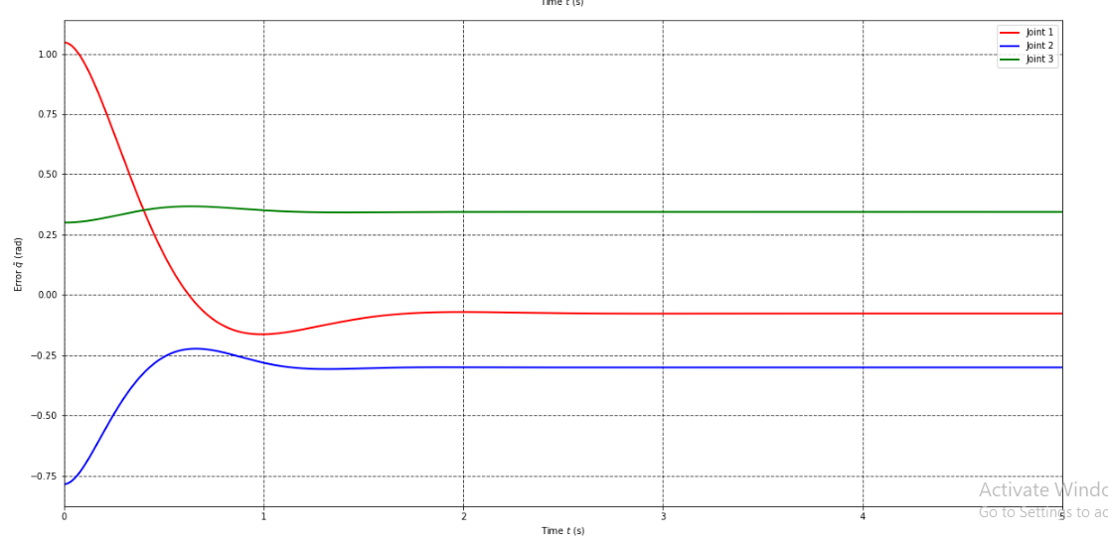
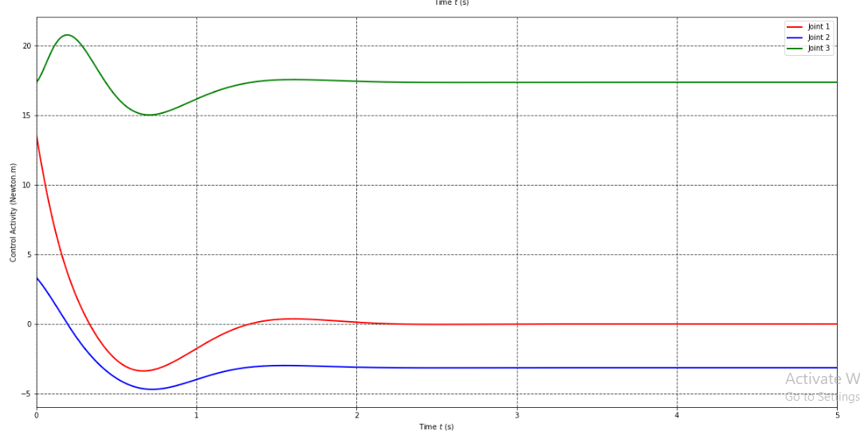
4- PD Controller (Aprox guesses)

Slide 14
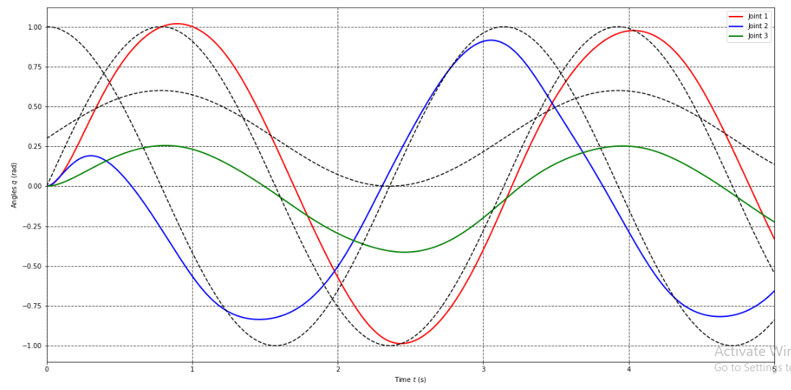
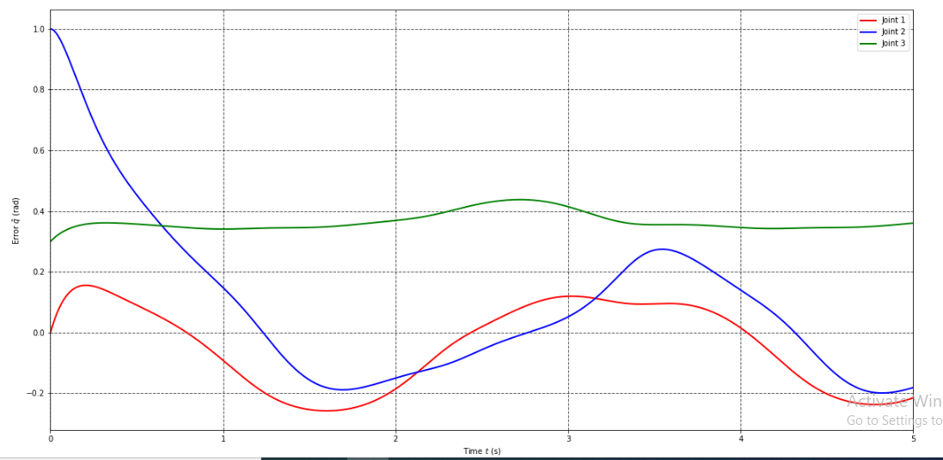
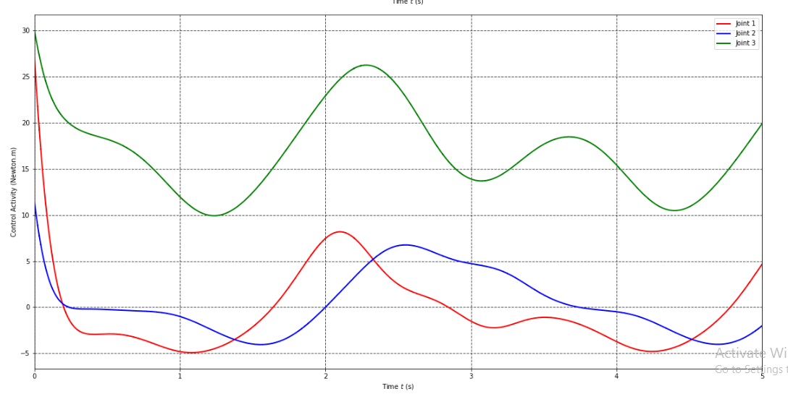
4- PD Controller (Aprox guesses)

Slide 15
Table of Content
Schematic Diagram
Dynamics of Manipulator
Regressor & Parameter vector
PD Control
Perfect guesses
Aprox guesses
Passivty Control
Perfect guesses
Aprox guesses
Passivty Robust Control
Aprox guesses
Aprox guesses + weight at end-effector

Slide 16
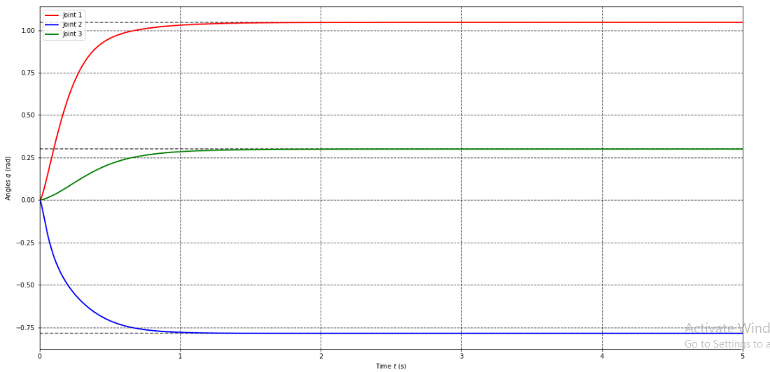
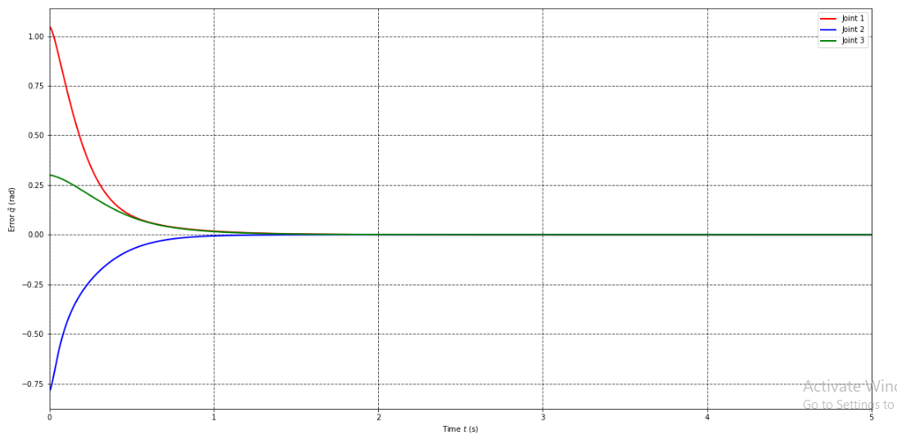
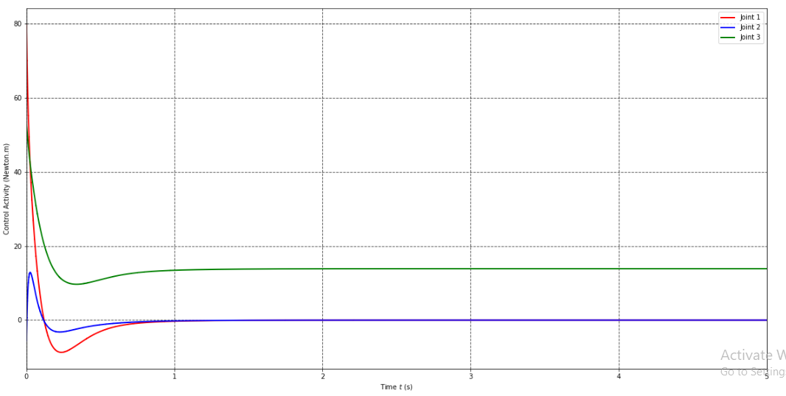
5- Passivty Control (Perfect guesses)

Slide 17
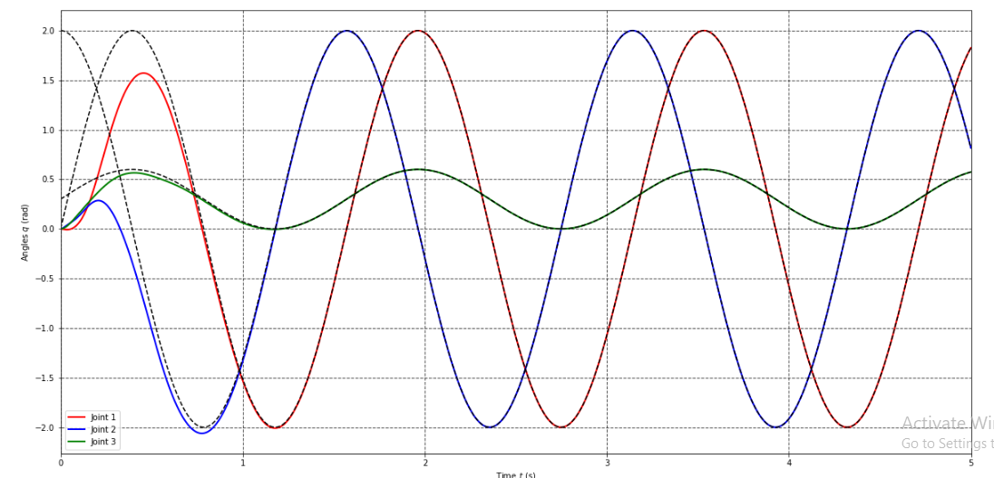
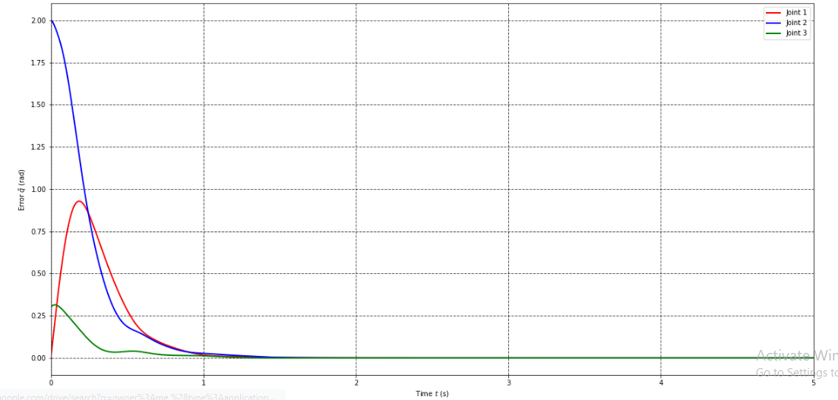
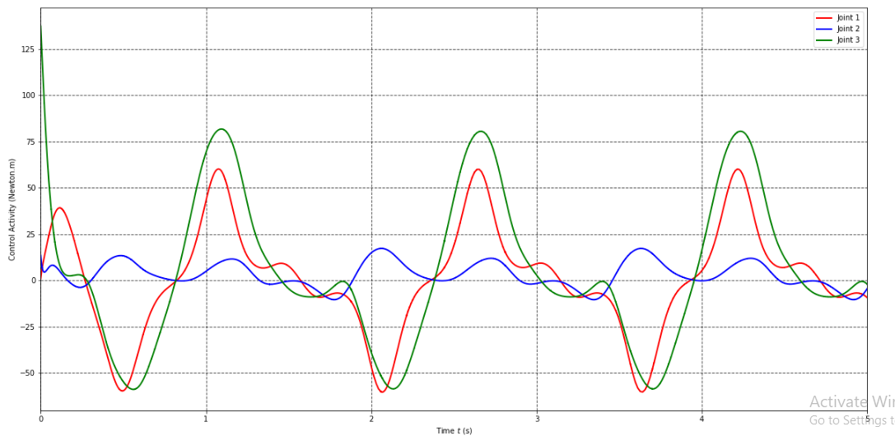
5- Passivty Control (Perfect guesses)

Slide 18
Table of Content
Schematic Diagram
Dynamics of Manipulator
Regressor & Parameter vector
PD Control
Perfect guesses
Aprox guesses
Passivty Control
Perfect guesses
Aprox guesses
Passivty Robust Control
Aprox guesses
Aprox guesses + weight at end-effector

Slide 19
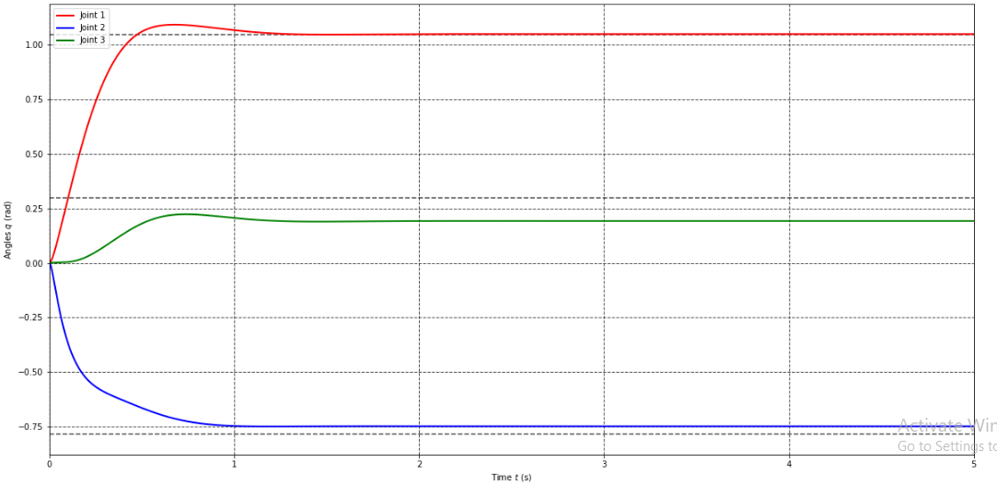
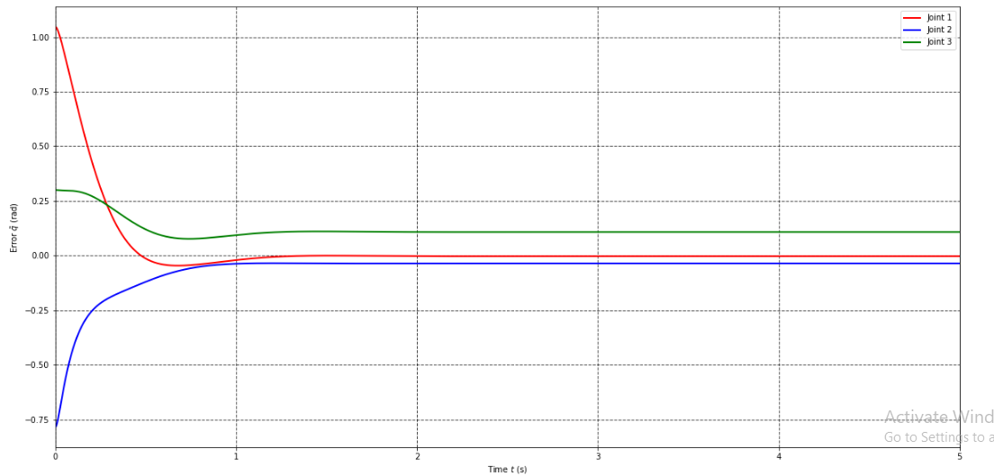
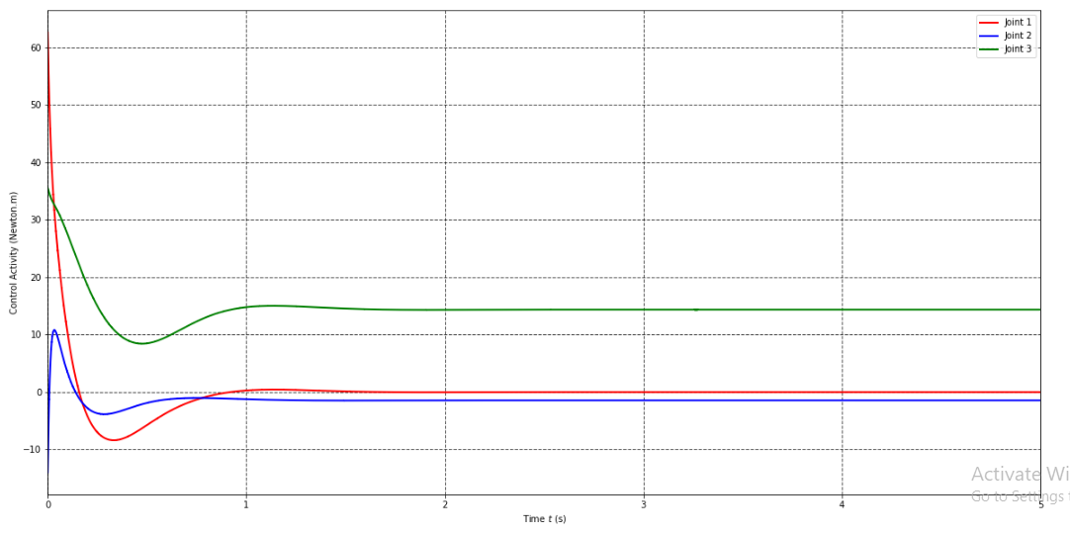
5- Passivty Control (Aprox guesses)

Slide 20
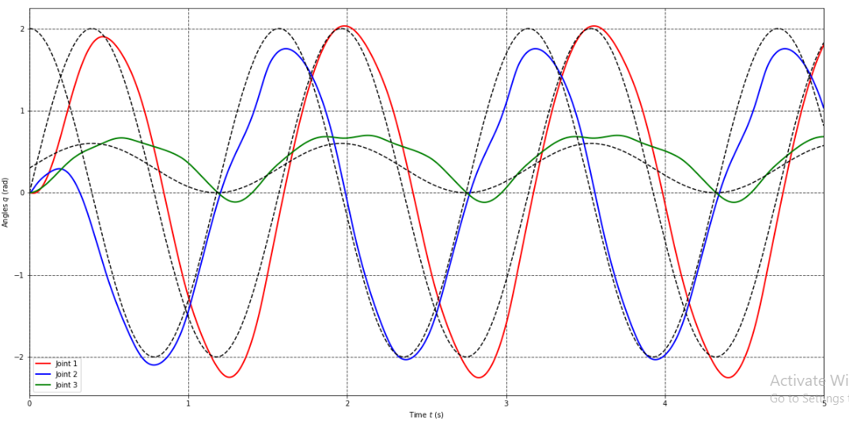
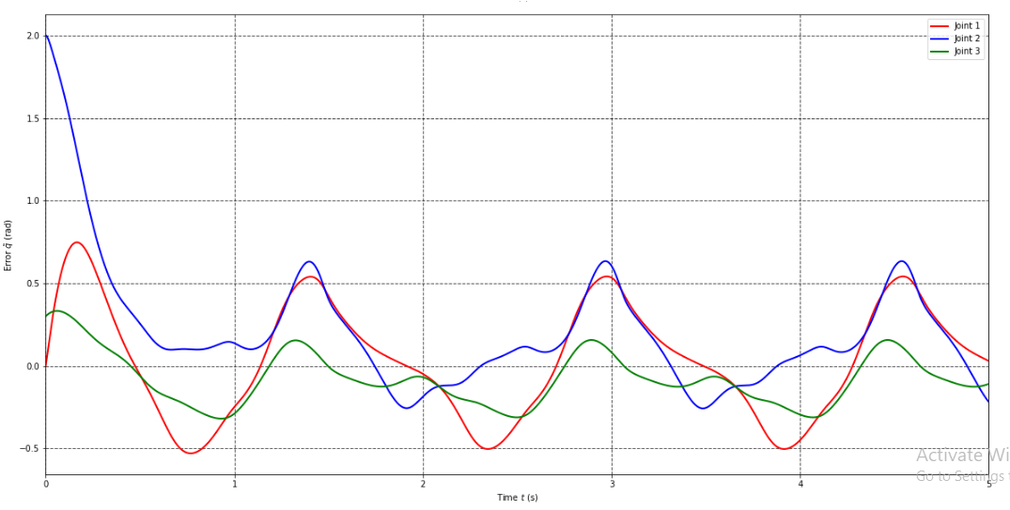
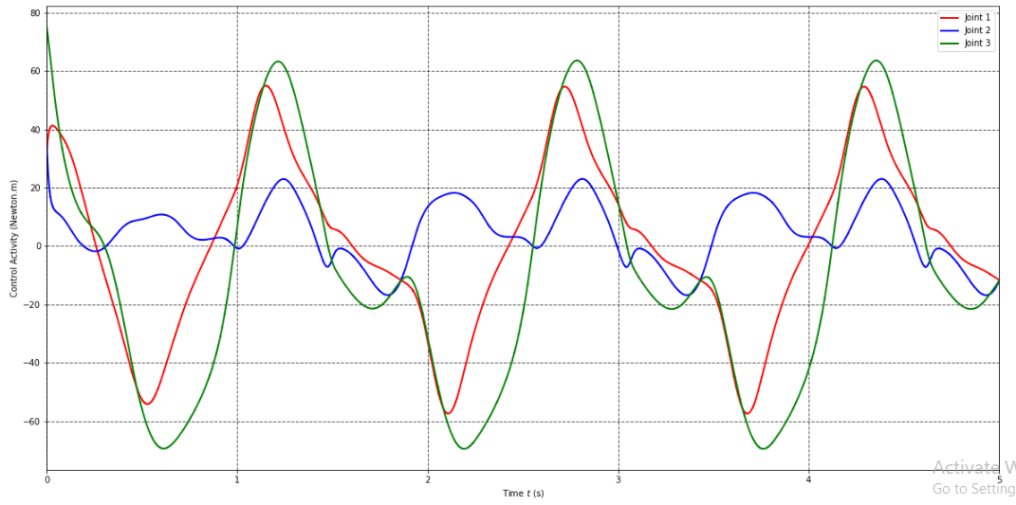
5- Passivty Control (Aprox guesses)

Slide 21
Table of Content
Schematic Diagram
Dynamics of Manipulator
Regressor & Parameter vector
PD Control
Perfect guesses
Aprox guesses
Passivty Control
Perfect guesses
Aprox guesses
Passivty Robust Control
Aprox guesses
Aprox guesses + weight at end-effector

Slide 22
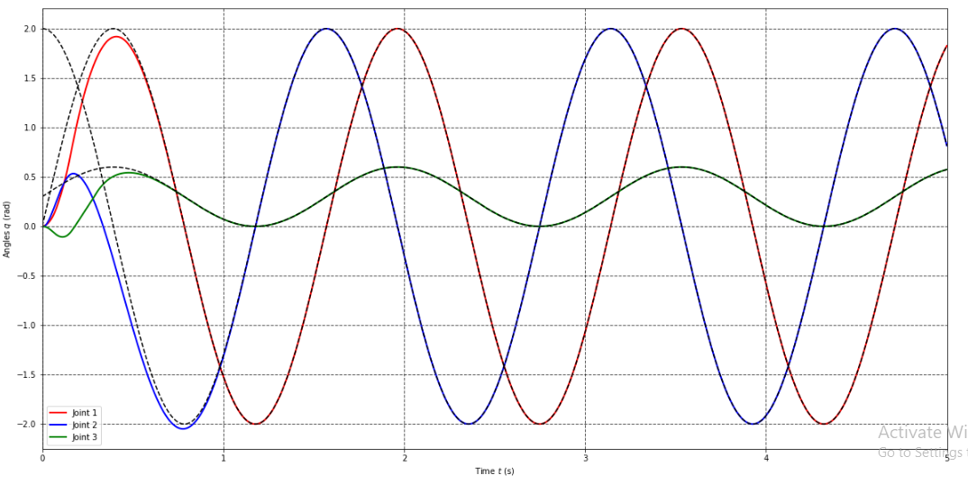
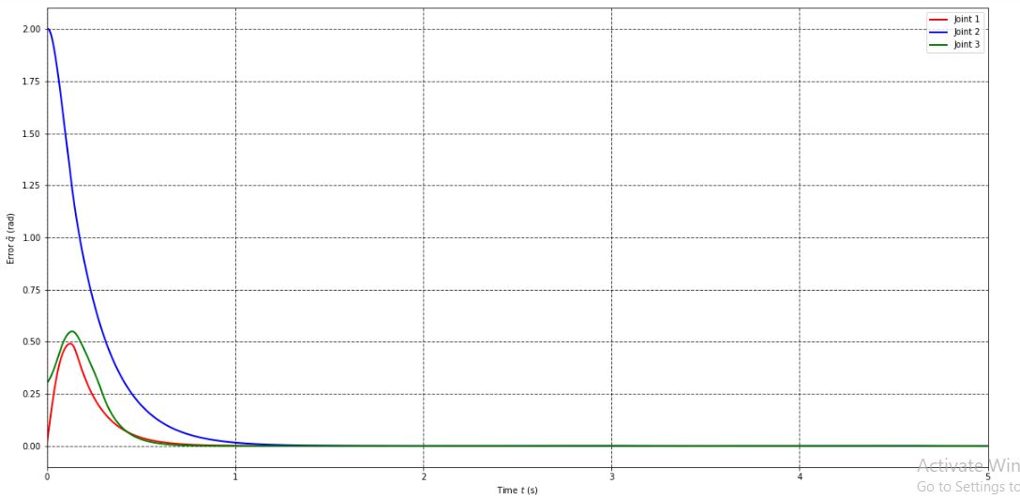
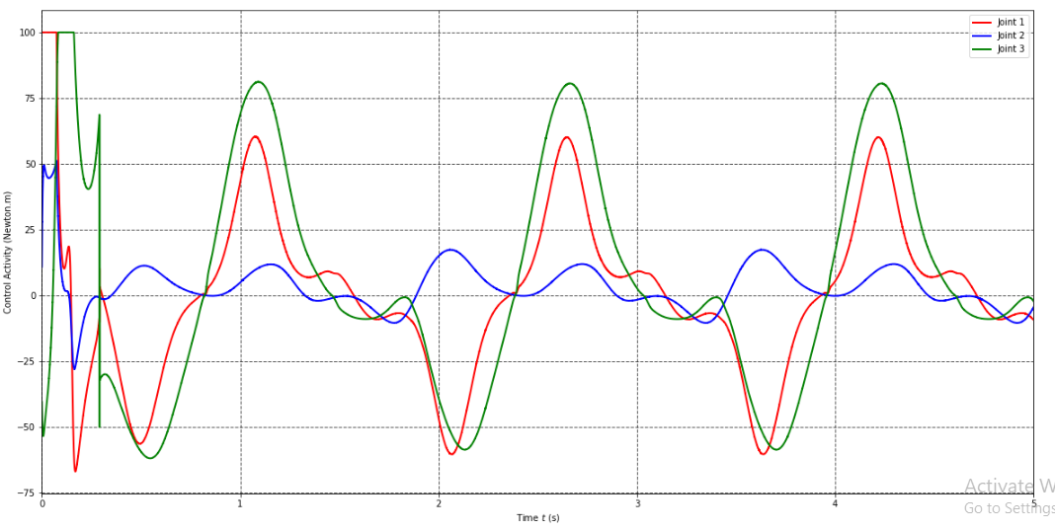
6- Passivty Robust Control (Aprox guesses)

Slide 23
Table of Content
Schematic Diagram
Dynamics of Manipulator
Regressor & Parameter vector
PD Control
Perfect guesses
Aprox guesses
Passivty Control
Perfect guesses
Aprox guesses
Passivty Robust Control
Aprox guesses
Aprox guesses + weight at end-effector

Slide 24
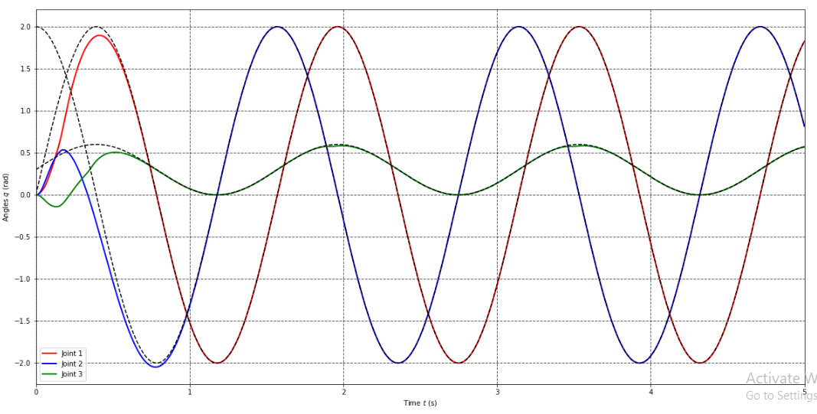
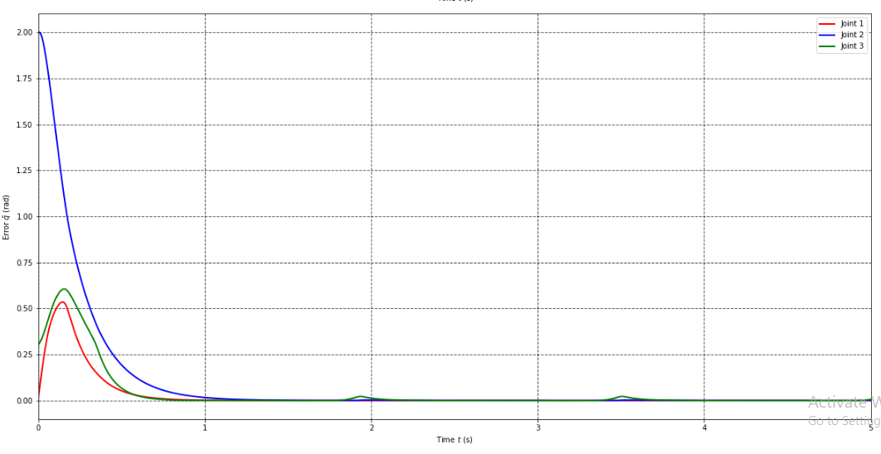
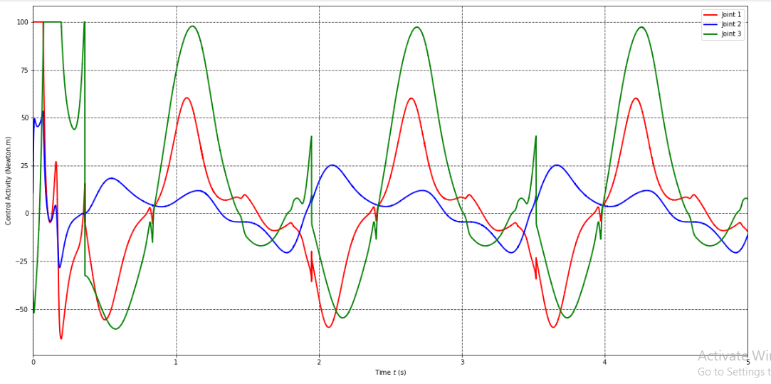
6- Passivty Robust Control (Aprox + Weight)

